Slide 1

Tourium: Sprint 2
John Arnett, Laney Brager, Brandon Hightower, Dallon Phipps
Notes:
John

Slide 2

Overview
Guided tours
Benefits: education
Difficulties: accessibility by offline mobile devices, ease of creation, cost.
Aim: give the audience the ability to create location-based guided tours around publicly accessible properties.
Intended Audience: public land managers, public service volunteers, community members, and visitors.
Notes:
Dallon

Slide 3
Sprint Goal
Differentiate user types
Manager vs. User
Begin creation of tours and information management using Firestore
Finish user management
verify email
Notes:
John

Slide 4

Major Sprint Achievements
Create and delete tours
Create points of interest
Change user emails and passwords
Verify emails
Error and warning messages
Notes:
John

Slide 5
Project Backlog and Sprint Backlog
Abort Tour while in Progress
In Medias Reas Tour Commencement
Visitor Upload Images
Visitor Comments
Moderate Comments/Images
Report Trail Issue
Report App Issue
Able to see nearby trails based on location
Brief tutorial at beginning of app
Scavenger Hunt
Download Offline Map
Hashtag Integration
Verify Manager
Record Route in Person
Modify Point of Interest
Location Profiles
Able to manage a tour from a website interface
QR Code to Access Trails
Manager Use Statistics Reports
Notes:
Laney

Slide 6
Lessons Learned
Working remotely is difficult
Not Completed
User functionalities: taking a tour live
Verifying managers
Notes:
Laney

Slide 7
Next Sprint Goals
Sprint 3 goals
Implement going through tours
Make manager use easier
Automate features for managers (i.e. usage statistics)
Add user features
Notes:
Laney

Slide 8
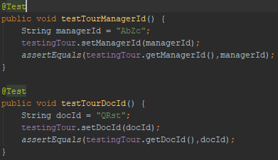
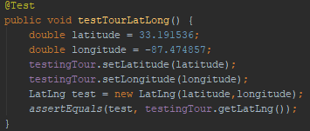
Test Cases
Notes:
Dallon

